Slide 1

LEARN PROGRAMMING WITH
KELVIN
kelvindsmn@gmail.com

Slide 2
MATERIAL
In this course we will learn about the following concepts :
Iteration
Nested Iteration

Slide 3
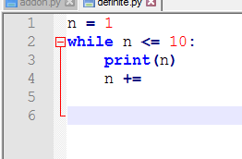
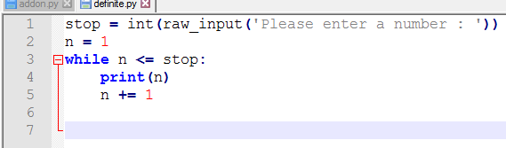
DEFINITE VS INDEFINITE LOOP
DEFINITE
INDEFINITE
DEFINIT
Definite means we can determine or predict how many iteration will be performed
Indefinite means we can’t determine or predict how many iteration will be performed, it all depends on the process or the input

Slide 4
INDEFINITE EXAMPLE
# Add On Negatives
sum = 0
negatives = False
while negatives != True:
entry = int(raw_input('Please enter a number : '))
if entry >= 0:
sum += entry
else:
negatives = True
#end while
print sum

Slide 5
FOR
for n in range(1, 11):
print(n)
range( begin, end, step )

Slide 6
For Usage
from __future__ import print_function
for n in range(21, 0, -3):
print(n , '', end= '')
21 18 15 12 9 6 3

Slide 7
NESTED LOOP
For x in range:
for y in range:
block

Slide 8
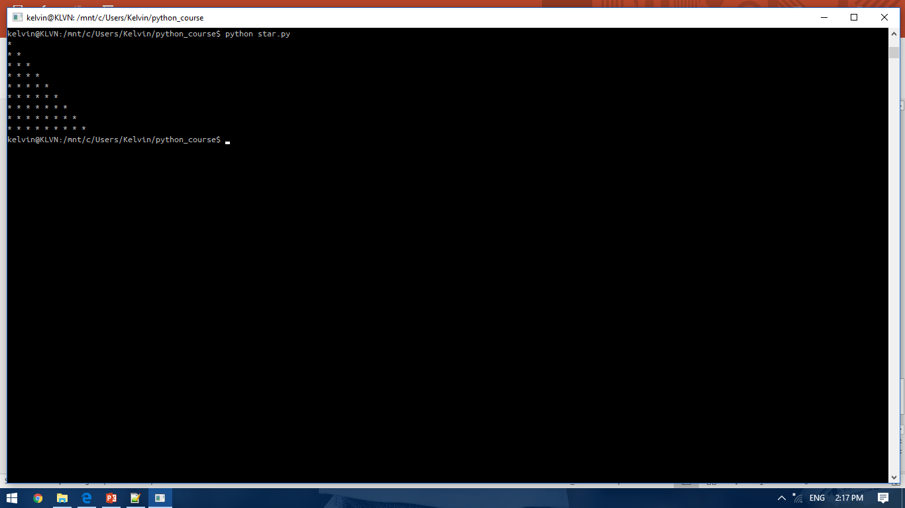
NESTED LOOP

Slide 9
NESTED LOOP
from __future__ import print_function
for i in range(1,10):
for j in range(1, i+1):
print ("*" , end=" ")
print()

Slide 10
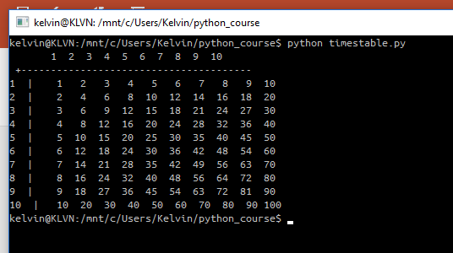
EXERCISE

